Slide 1
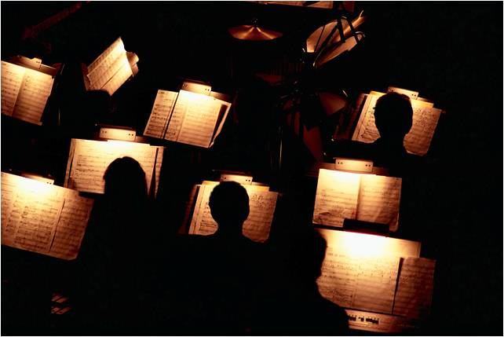
Orchestra Instruments
Presented by Long Nguyen speech 101

Slide 2
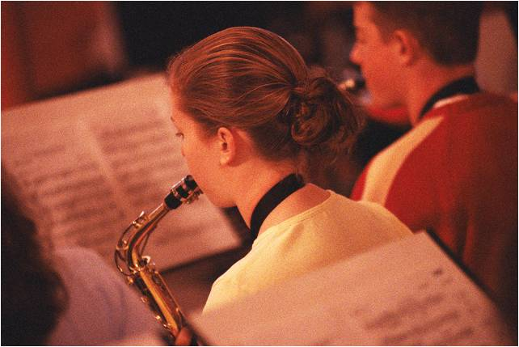
Instrument Categories
Type | Specific Instruments
Strings | Violin, viola, cello, double bass
Woodwinds | Flute, oboe, clarinet, bassoon
Brasses | French horn, trumpet, tuba
Percussion | Drums, triangle, cymbals, tambourine

Slide 3
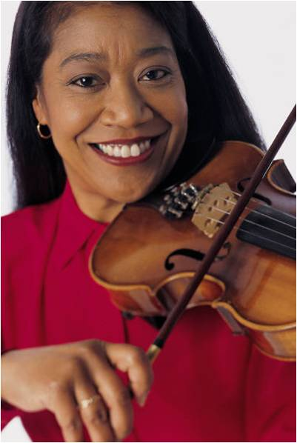
Strings
Produce sounds through string vibration
Normally played with bow
Can be plucked
Harp occasionally joins the string section

Slide 4
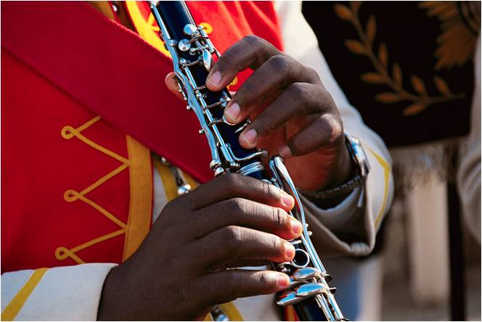
Woodwinds
Played by blowing through a mouth hole or on a vibrating reed
The larger the instrument the larger the pitch

Slide 5
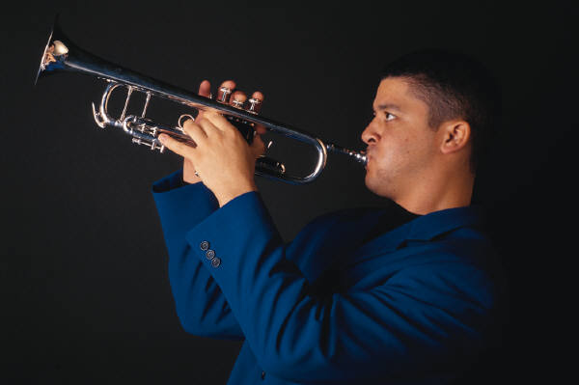
Brasses
Played by the action of valves and musician’s lips on the mouthpiece

Slide 6
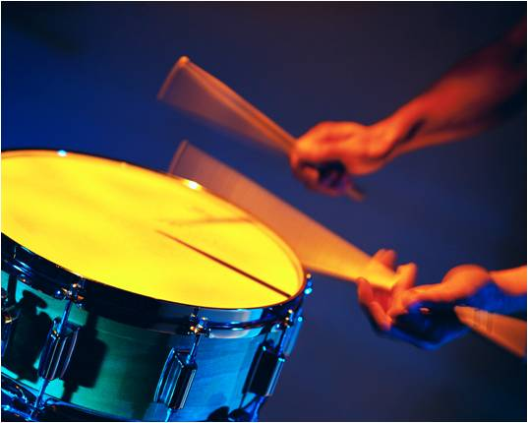
Percussion
Played by being struck, rubbed, or shaken
Provide the rhythm beat in an orchestra

